Slide 1
Protein Secondary Structure Prediction
By
Mrs. Aparna Patil Kose
Lecturer
Dept of Bioinformatics

Slide 2
Importance of studying secondary structure prediction
Protein structure plays a key role in its function; if a protein loses its shape at any structural level, it may no longer be functional
The secondary structures play important roles in protein structure and protein folding.
The sequence–structure gap is rapidly increasing.
Currently, databases for protein sequences (e.g., SWISS-PROT, GenBank, DDBJ, NCBI reference sequence, EMBL) are expanding rapidly, largely due to large-scale genome sequencing projects at the beginning of 1998.
Therefore the gap between the number of protein structures in public databases (PDB) and the number of known protein sequences is increasing.
This implies that despite significant improvements of structure determination techniques (X-ray crystallography, NMR spectroscopy, and electron microscopy), methods are not feasible because they are costly, tedious and time consuming, taking months or even years to complete.

Slide 3
CONT’D
A protein’s biological function is dictated by the arrangement of the atoms in the three dimensional structure.
This could be the arrangement of catalytic residues in an active site or how a protein interacts with other proteins for structural or other regulatory purposes.
Having a protein structure provides a greater level of understanding of how a protein works, which can allow us to create hypotheses about how to affect it, control it, or modify it.

Slide 4
CONT’D
Although gradual progress has been made in protein 3D structure prediction, the outcomes have not reached the adequate level of structural accuracy compared to those of the experimental methods of protein structure determination which are the bases of performance evaluation for the quality of protein tertiary structure prediction.
At a structural level, the tertiary structure of a protein can be defined with less complexity by secondary structures which are formed by the hydrogen bonds between the amine hydrogen and carbonyl oxygen atoms of a protein’s backbone peptide bonds.
The secondary structures are grouped broadly to helices, strands and loops/turns which exhibit distinct geometrical features in form of regular and repetitive folds, and coils.

Slide 5
CONT’D
The protein secondary structure (PSS) prediction methods are utilized in protein tertiary structure modeling techniques to achieve two goals:
(1) Reducing the computational cost and complexity of 3D structure modeling.
(2) Having benefits from the fact that protein structures are more preserved than amino acid sequences.
In de novo methods, where protein 3D structures are modeled from amino acid sequences, it has been observed that incorporating the information of accurately predicted secondary structures improves greatly the overall performance.
Protein secondary structure prediction is often an important component of a number of computational biology tools for distant homology detections and multi-sequence alignments.

Slide 6
CHALLENGES of solving protein structures?
From an experimental point of view, the largest challenges are cost, time and expertise.
Solving structures using crystallography and NMR requires extremely specialized training, a high degree of skill, and a lot of luck.
The cost of solving a new, unique structure is on the order of $100,000.
Given the difficulty of solving an experimental structure, and considering the rate at which new protein sequences are discovered, it has become clear that with today’s technology, we will not solve structures for all the new proteins being identified and sequenced.
Comparing the number of protein sequences in UniProt to the number of known structures in the PDB, we see about 400 times more sequences than structures.
So we’re not going to catch up any time soon.
Finding alternative ways to predict a protein structure becomes more and more important as this gap increases.

Slide 7
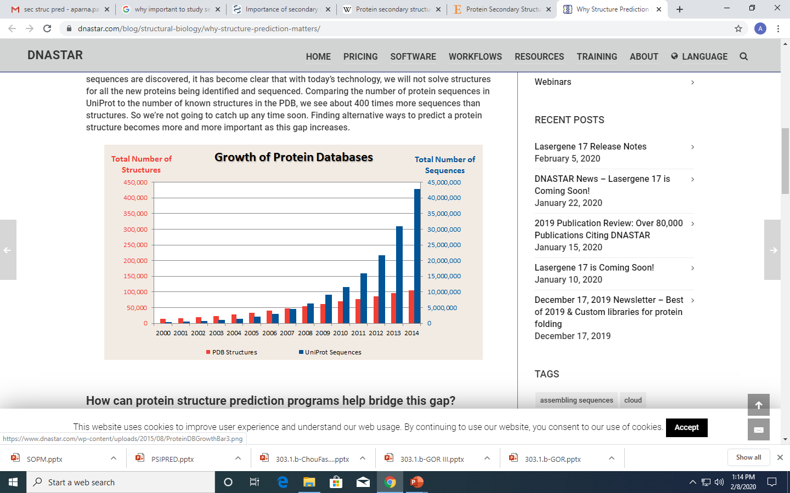

Slide 8
How protein structure prediction programs help bridging this gap?
Many tools for protein structure prediction rely on homology modeling.
This works by using sequence alignment to identify proteins that have a high degree of sequence similarity in the Protein Data Bank.
These methods work well for proteins with at least 70% sequence identity.
But relying on sequence similarity alone has its weaknesses.
As you get closer to 50% sequence identity, it becomes difficult to select templates.
Where as you get closer to the 30% sequence identity level, or the “twilight-zone,” it becomes exceedingly difficult, because any two random pairs of proteins can have this level of sequence identity.
Therefore many tools uses a hybrid approach that uses protein threading to select templates which predict the solvent accessibility, and predicted internal contacts, in addition to sequence similarity.

Slide 9
How does one know if a predicted model is accurate?
In structure prediction, it is important to have tools to understand how much confidence you can have in predicted models.
In turn, models can be used for different purposes depending upon their confidence scores.
i.e.
Lower confidence models can be used to predict domain boundaries
mid-level confidence models are reasonable for doing protein design experiments, creating site-directed mutations, and predicting binding sites.
models with the highest confidence scores are appropriate for workflows like ligand and small molecule docking, virtual drug screening, and protein-protein docking.
In the end, people will always ask if experimental evidence is needed to prove the predicted models are correct.
Experimental validation will still be important, but that doesn’t have to be experimental structure determination.

Slide 10
Secondary Structure Prediction METHOD
Secondary structure prediction is a set of techniques in bioinformatics that aim to predict the local secondary structures of proteins based only on knowledge of their amino acid sequence.
METHODS OF SECONDARY STRUCTURE PREDICTION
Basically there are three generations of secondary structure prediction methods.
Each new generation has overall accuracy of about 10% higher than methods from previous generation
First Generation
Second Generation
Third Generation

Slide 11
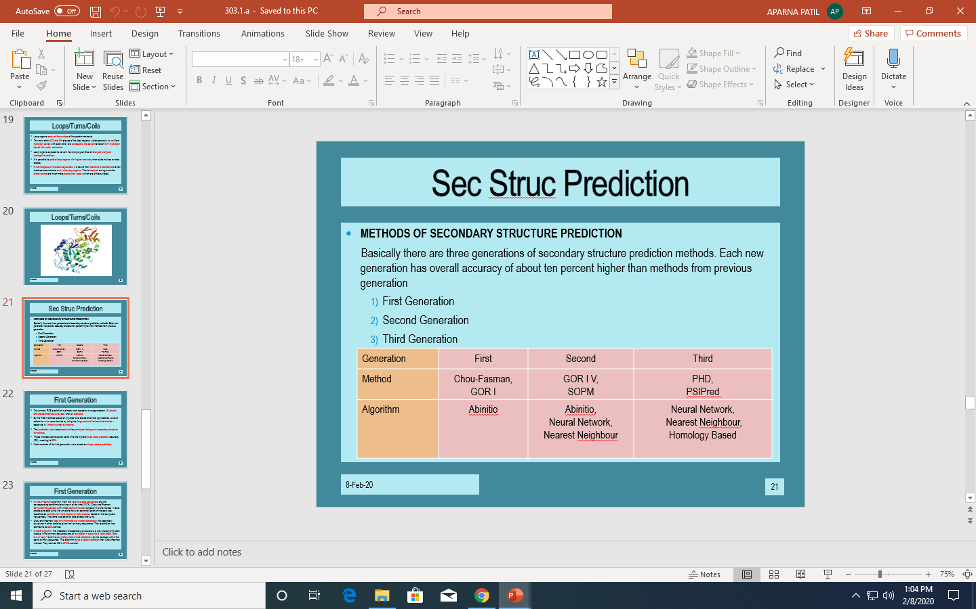

Slide 12
FIRST GENERATION
The primary PSS prediction methods were based on two approaches: (1) physic and stereo-chemical analyses, and (2) statistics.
By the PSS methods based on physico- and stereo-chemical approaches, a set of extensive rules were derived by using the frequencies of helices and strands observed in limited number of proteins.
The prediction rules were based on the principles that govern secondary structure formations.
These methods achieved for some time the highest three state prediction accuracy (Q3), reaching to 56%.
Most methods of the first generation were based on single residue statistics.

Slide 13
CONTD
In Chou-Fasman algorithm, from the 15 amino acid sequences and the corresponding conformations known at the time (1974), Chou and Fasman computed frequencies with which each amino acid appears in alpha helices, in beta sheets and beta turns. For an alpha helix for example, each amino acid was classified as helix-former, helix-neutral or helix-breaker based on the computed frequencies. The same was done for beta sheets and turns.
Chou and Fasman used this information to predict statistically the secondary structures in other proteins given their primary sequences. Their prediction was claimed to be 50% correct.
In GOR algorithm, the prediction of secondary structures is a way of assigning each residue in the primary sequence one of four states – alpha helix, beta sheet, beta turn or loop – and it is completely determined statistically by the residues within the same primary sequence. This algorithm gave a better prediction than Chou-Fasman method. They claimed Q3 is 57.0% correct.

Slide 14
SECOND GENERATION
The main improvement of the second generation of prediction techniques was a combination of a larger database of protein structures and the use of statistics based on segments.
The accuracy levels were slightly higher than 60%.
Mainly used algorithms were based on statistical information, physico-chemical properties, sequence patterns, 3-layered neural networks, graph-theory, multivariate statistics, expert rules and nearest neighbour algorithms.
This new version of the GOR method claimed Q3 is 63.0%.
Qian and Sejnowski used neural network based algorithm to predict the secondary structure in 1988.The neural network they used had three layers. They claimed Q3 is 64.3%.

Slide 15
THIRD GENERTION
Methods in the third generation are superior (in terms of accuracy) to their predecessors because based on sequence homology.
In homologous PSS prediction methods, a protein database is scanned to detect the homology between the segments of a query sequence and those of the template sequences, the prediction is made by a nearest-neighbor technique.
In a protein database, all sequences are scanned by a fixed-length sliding window which moves one residue at a time along sequences.
The homology-based PSS methods achieved an average of 60% prediction accuracy on a limited number of protein sequences.

Slide 16
What are some of the current and future applications of protein structure prediction?
Predicted models are already being used for drug screening using homology modeling in well understood systems, such as kinases.
There is a lot of interest in structure prediction as a screening process for proteins that are not tenable for experimental determination. For example, companies working on antibody development can generate thousands of antibody sequences in response to targets. They need to screen out antibodies that don’t have desired characteristics as quickly as possible. One way to improve this quick-to-fail mentality is to use structure prediction to predict properties of a protein fold based on the amino acid sequence.
These tools will also be used for protein engineering. i.e. to reach a level of accuracy where you can predict a structure and use that to design increased or reduced affinity to binding partners without the need for an experimental structure.
People may also want to model genetic variation into a protein structure, from site-directed mutations to large insertions and deletions, to predict the structures, and by extension, the biological effects of those variants.
Having tools to probe the structure-function relationship for individual targets is going to become even more important as we try to reduce the time and cost required to do these studies.

Slide 17
Tool for Secondary protein structure prediction
GOR/SOPMA/ExPASY

Slide 18
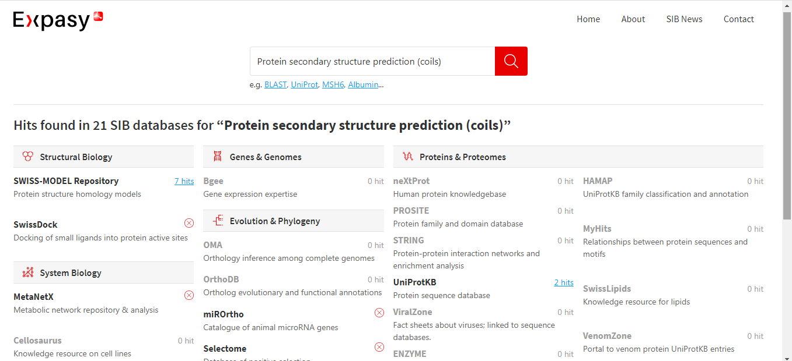
ExPASY: https://www.expasy.org/search/Protein%20secondary%20structure%20prediction%20(coils)?type=keyword

Slide 19
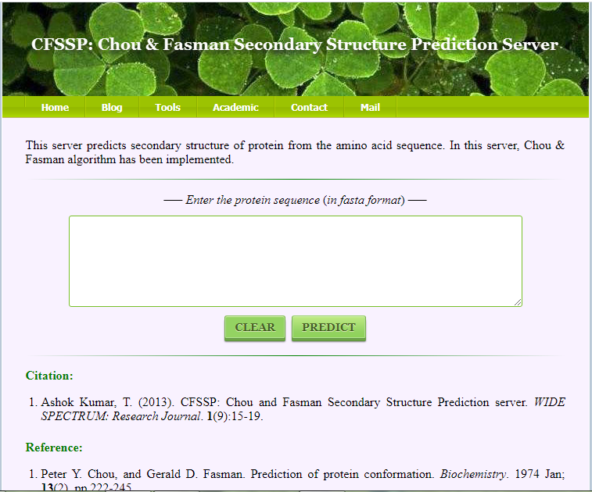
CHOU & FASMAN: http://www.biogem.org/tool/chou-fasman/index.php

Slide 20

GOR IV: https://npsa-prabi.ibcp.fr/cgi-bin/npsa_automat.pl?page=/NPSA/npsa_gor4.html

Slide 21

PHD: https://npsa-prabi.ibcp.fr/cgi-bin/npsa_automat.pl?page=/NPSA/npsa_phd.html

Slide 22
PRACTICAL
Tool for Secondary protein structure prediction
CHOU & FASMAN (1st generation)
GOR IV (2nd Generation)
PHD (3rd Generation)

